Slide 1
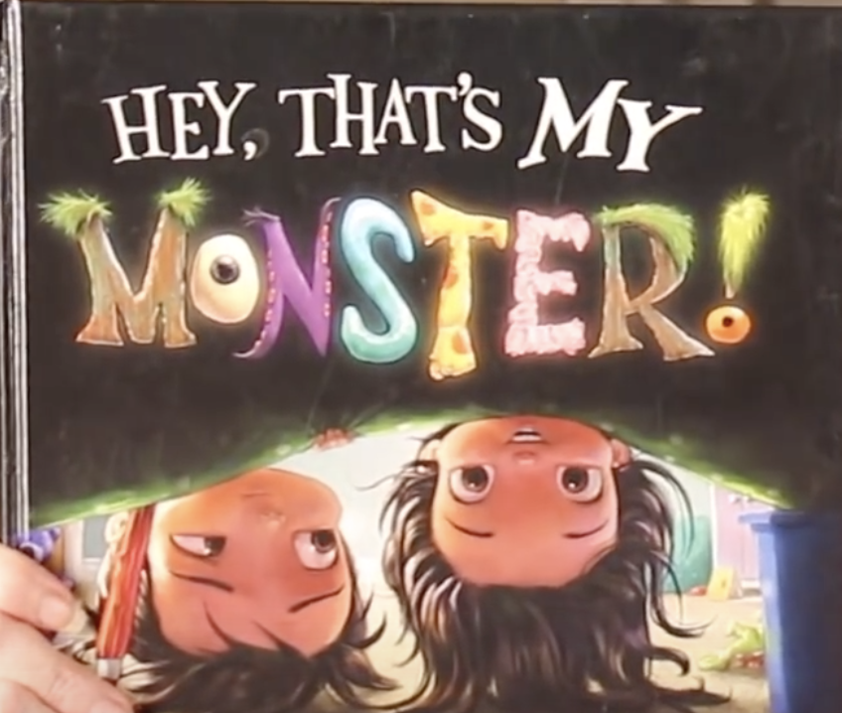
Pictures of pages in this book are coming up next.
Open your Reader’s Notebooks to My Word Collection on page 61.

Slide 2
If you see a word from this page you like, write it in your Word Collection. I highlighted some words for you to consider. But if you like one I did not highlight even better, you may write that word instead.
leaped
scrunched

Slide 3
gulped, zoomed
leaped
grab

Slide 4
creaking
sniffled.
squelched
dripped.

Slide 5
Tentacles swarmed
shrank
horror
enchanted.
Do you see an onomatopoeia?

Slide 6
See if you can find a good one without my highlights!

Slide 7
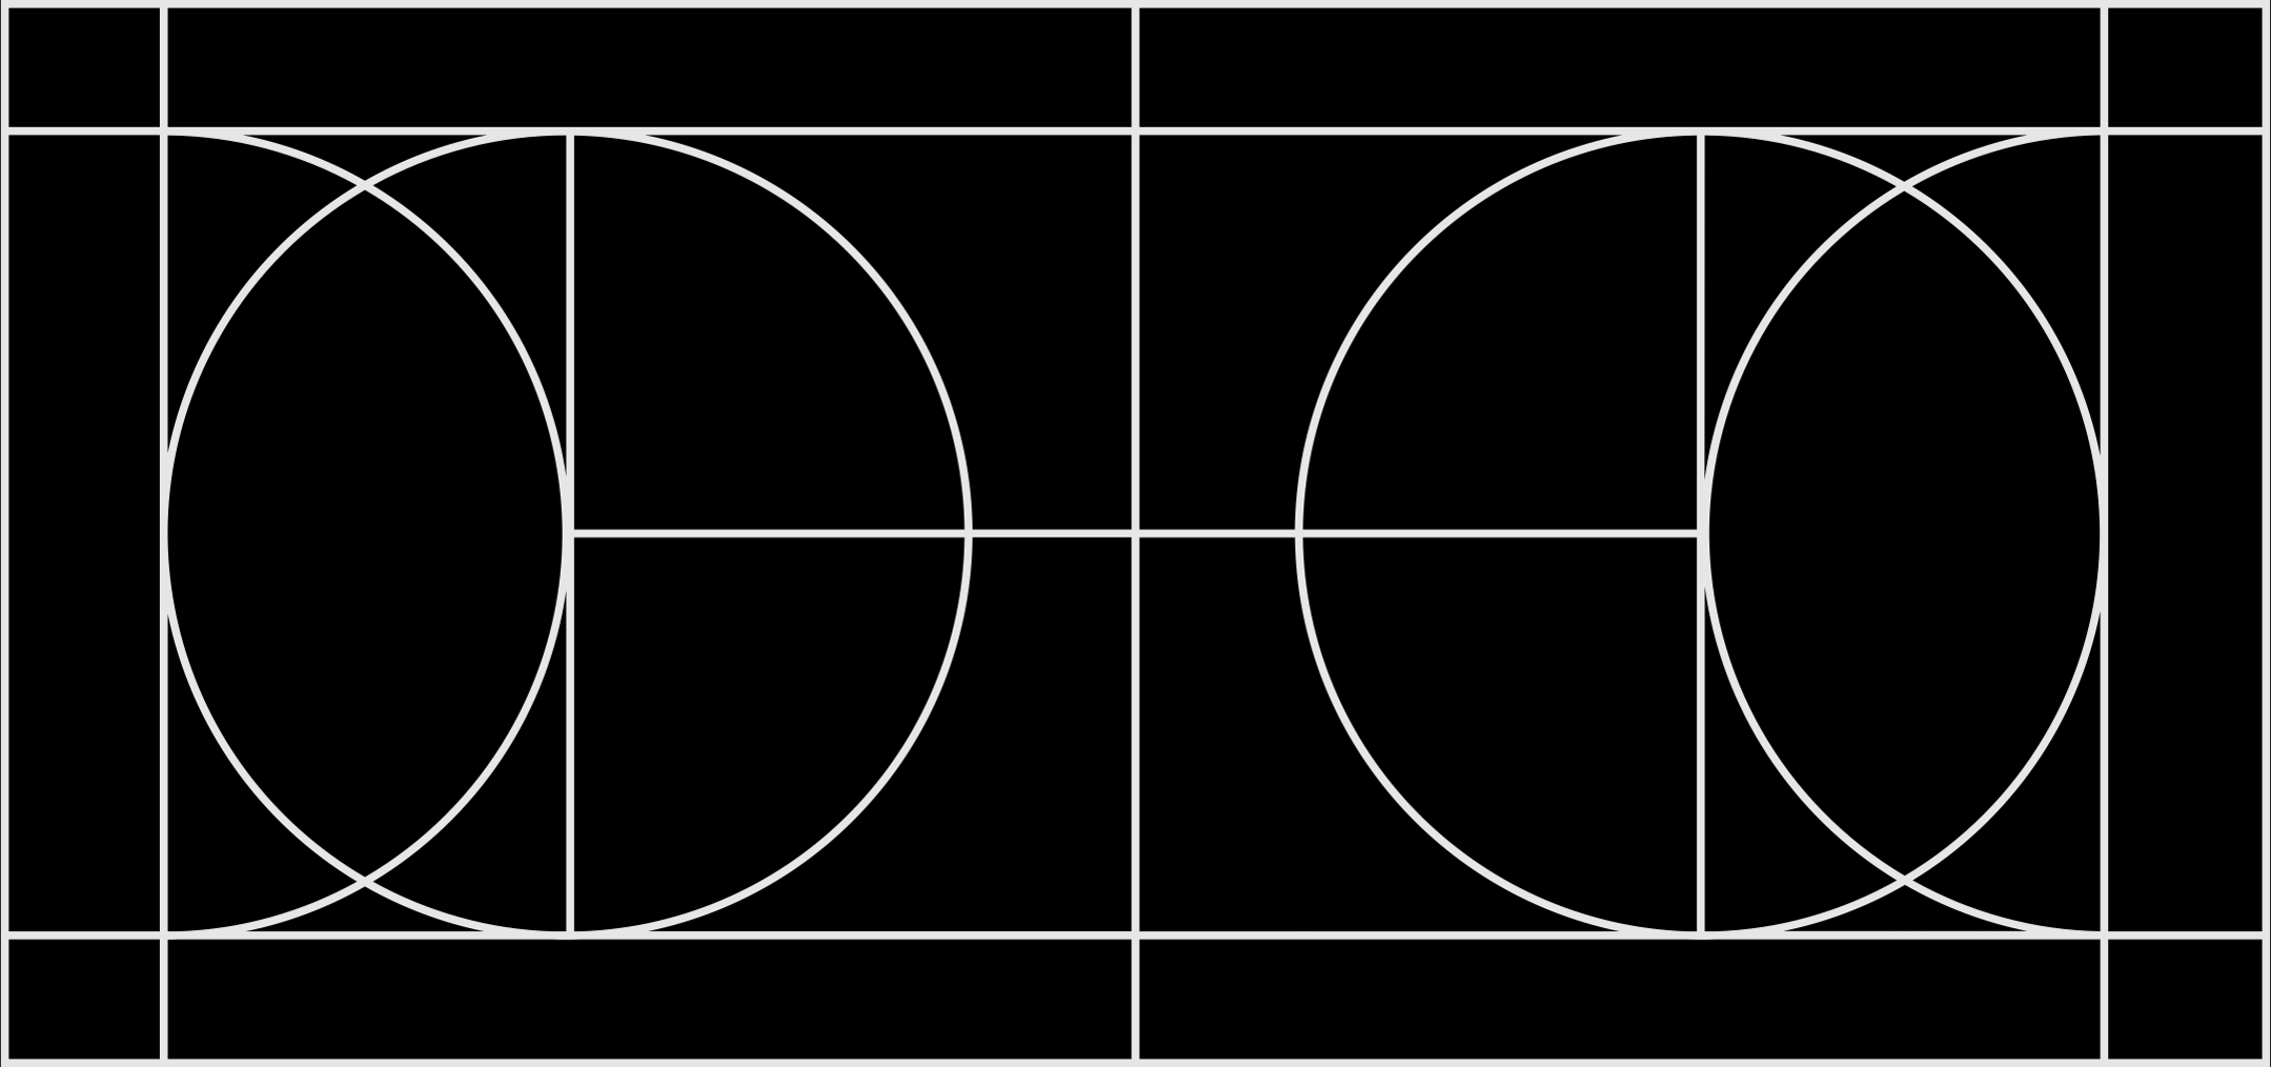
I bet you found one!
Now try this one on your own.

Slide 8
I hope you enjoyed collecting words with me today. Continue adding to your list as you read books from the library or from your own home.
Want to share your favorite words you collect this week? Use this link and add them to our Padlet.
Our Word Collection Padlet
You may want to add where you found your word such as “newspaper”, “tv show” or add the title of the book.
I have an example on there for you.
-Mrs. Barker

